Slide 1
Presenting Research

Slide 2
APA style
Set of guidelines for writing in psychology and related fields.
Large number and variety of guidelines. APA’s publication manual is nearly 300 pages
The goal of this video: Go over how to write a paper in APA style
Title page
Abstract
Introduction
Method
Results
Discussion
References

Slide 3
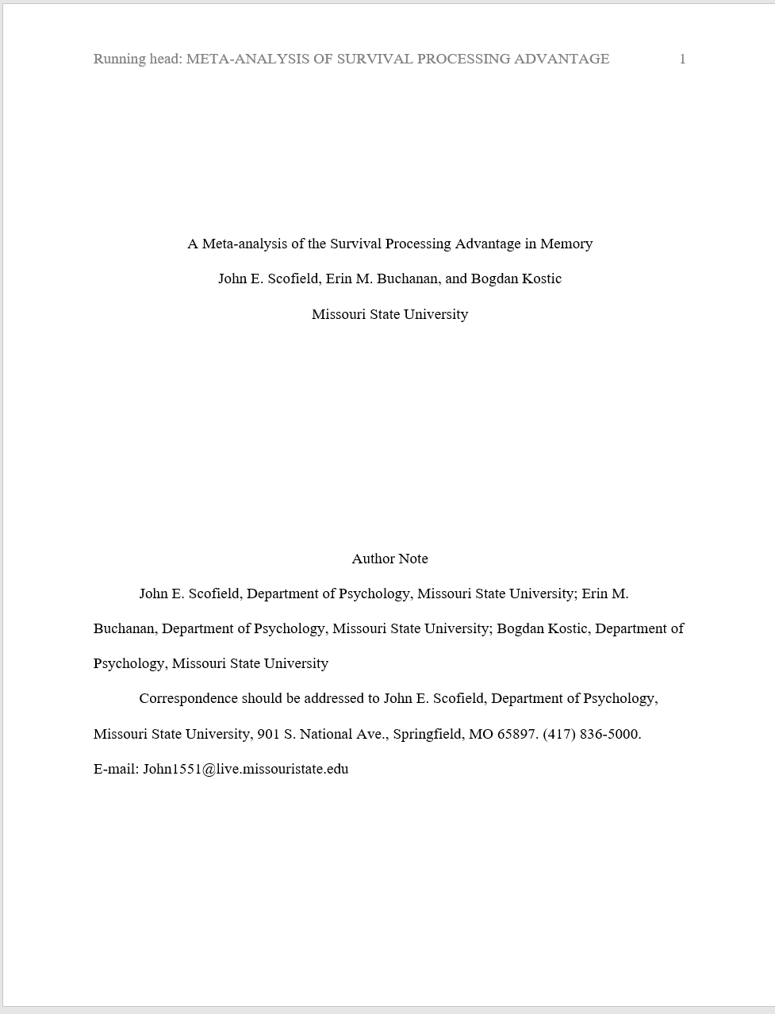
Title Page

Slide 4
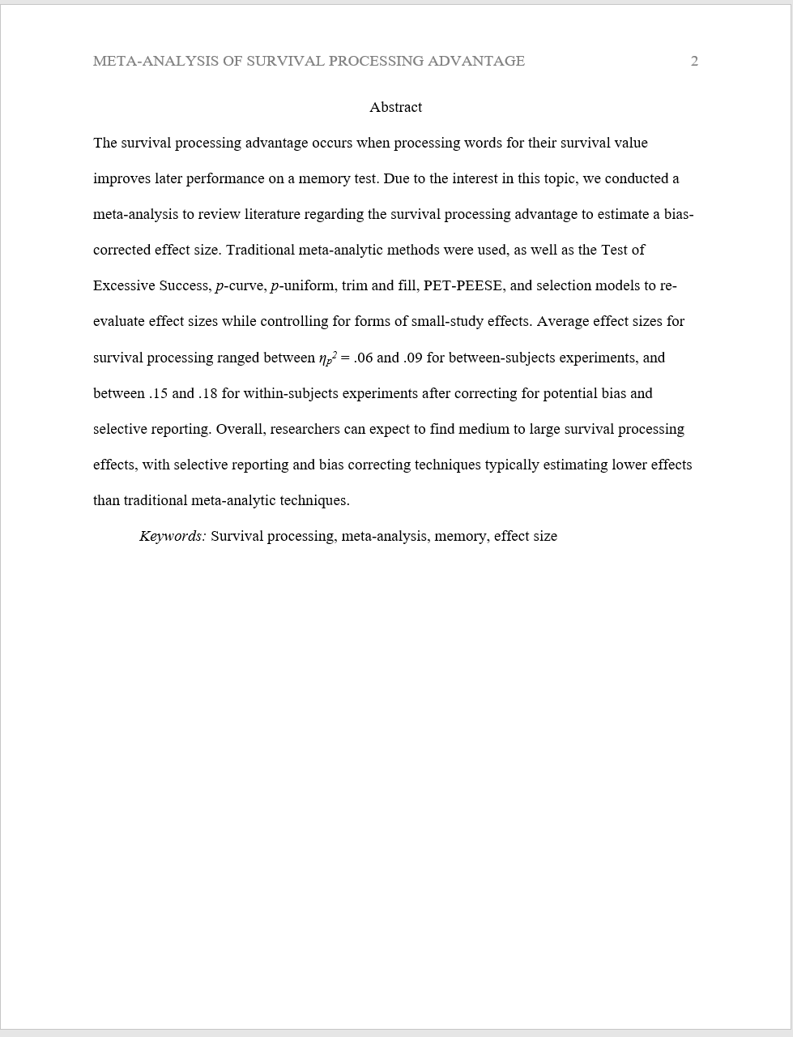
Abstract

Slide 5
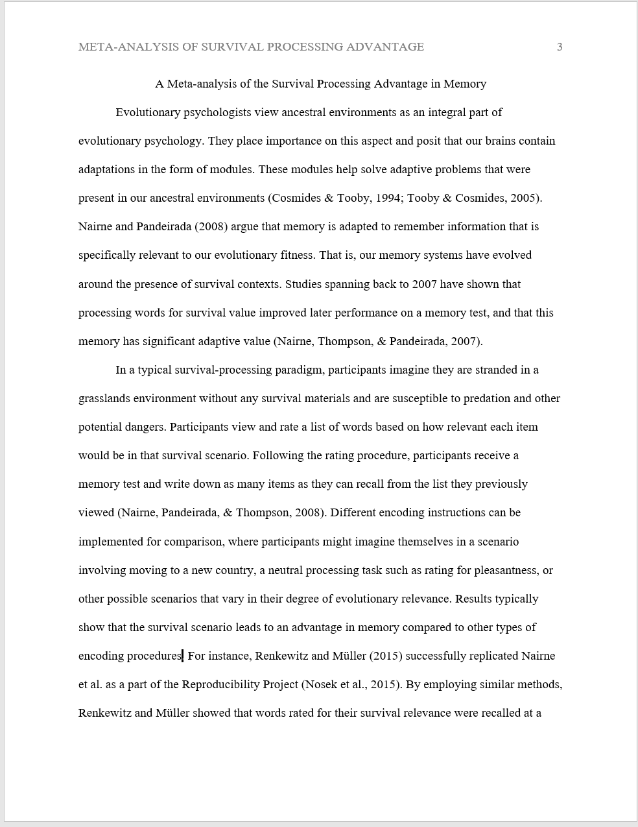
Introduction

Slide 6
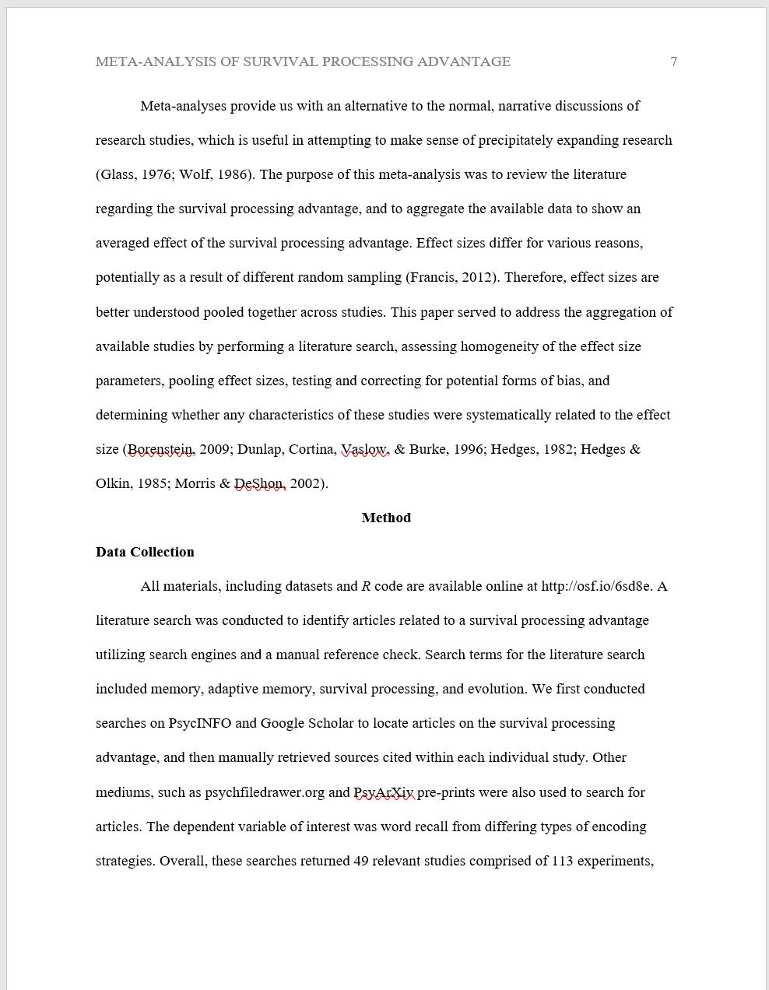
Method

Slide 7
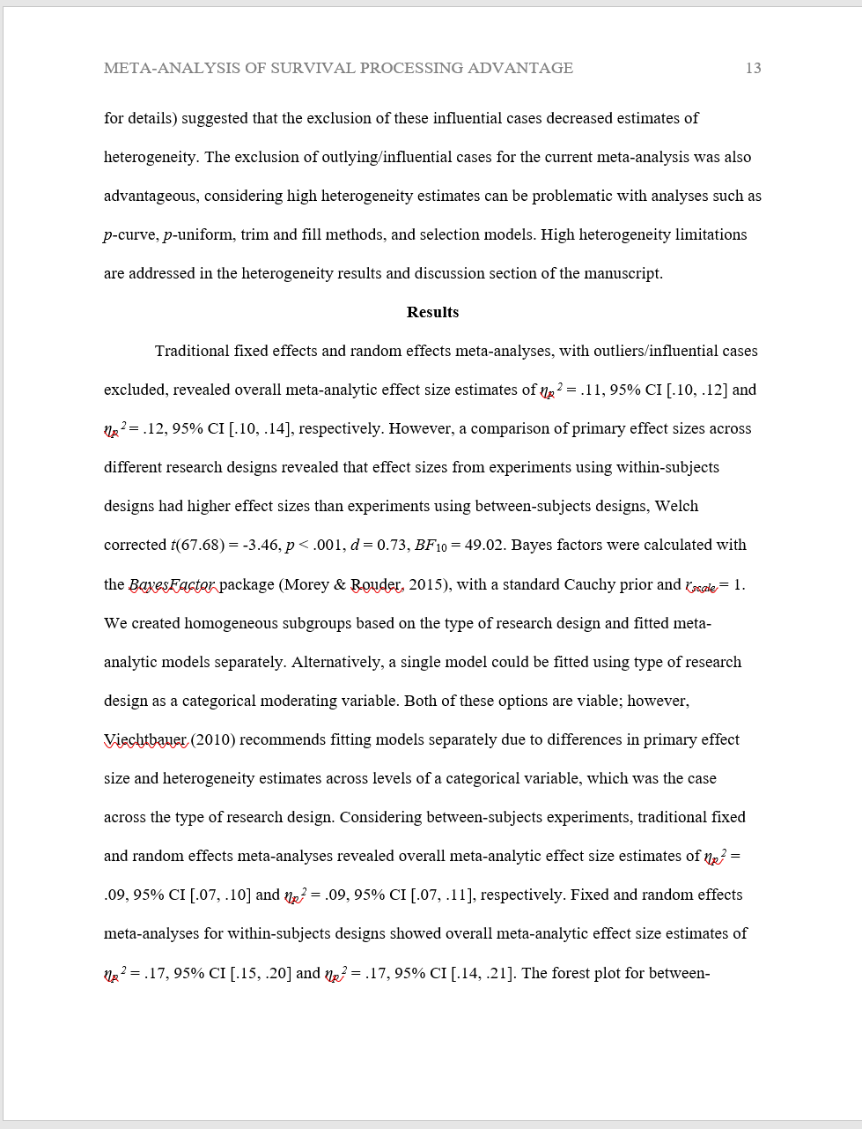
Results

Slide 8
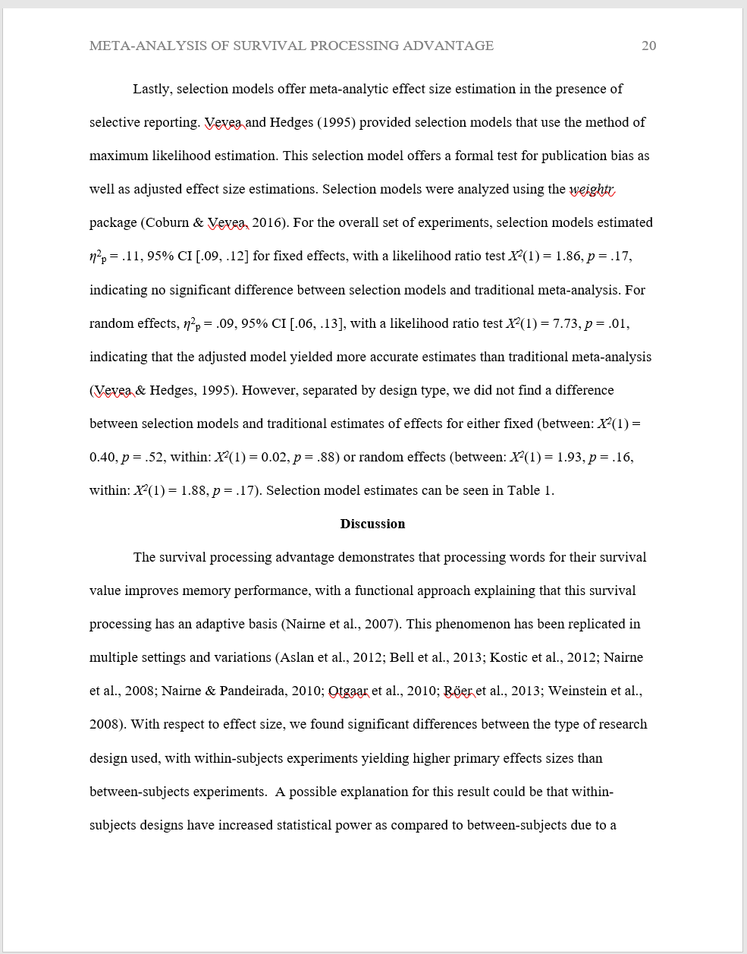
Discussion

Slide 9
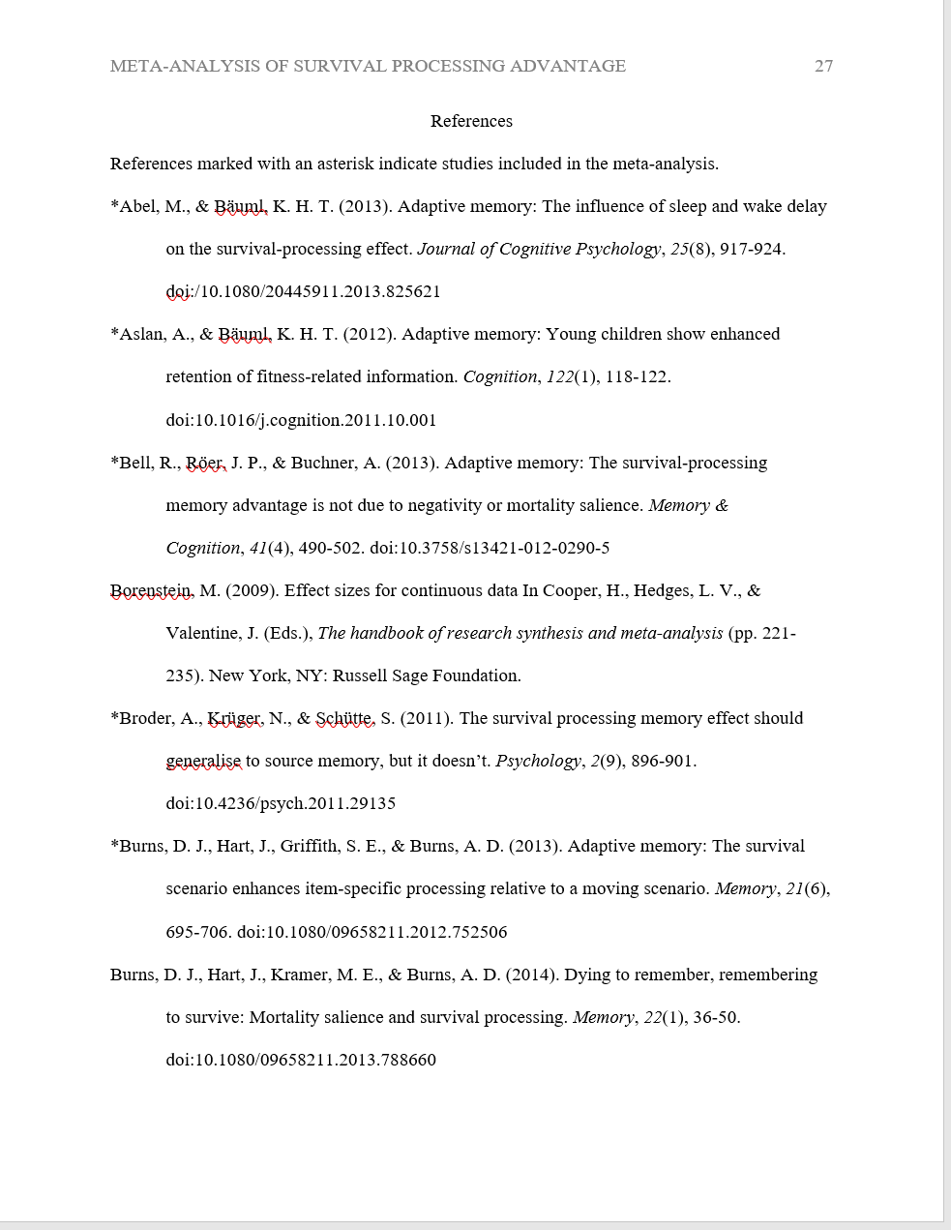
References

Slide 10
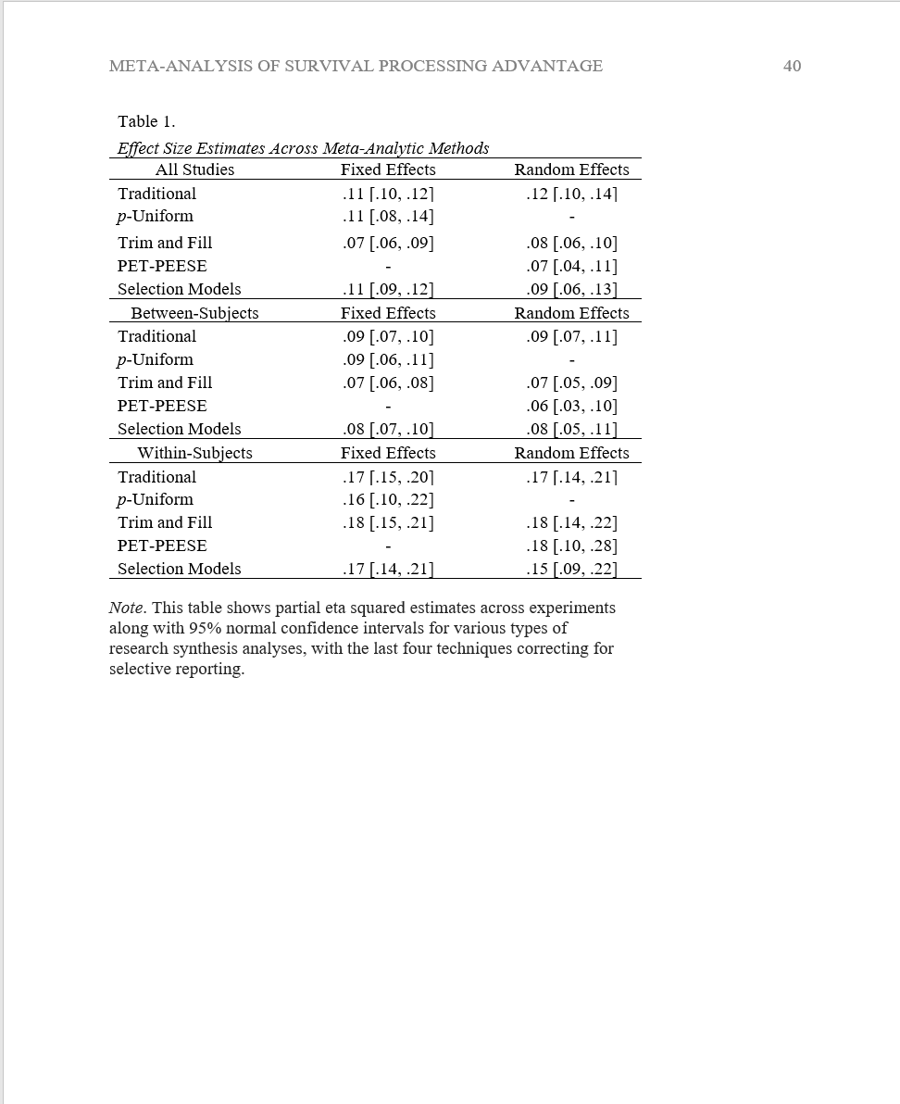
Tables

Slide 11
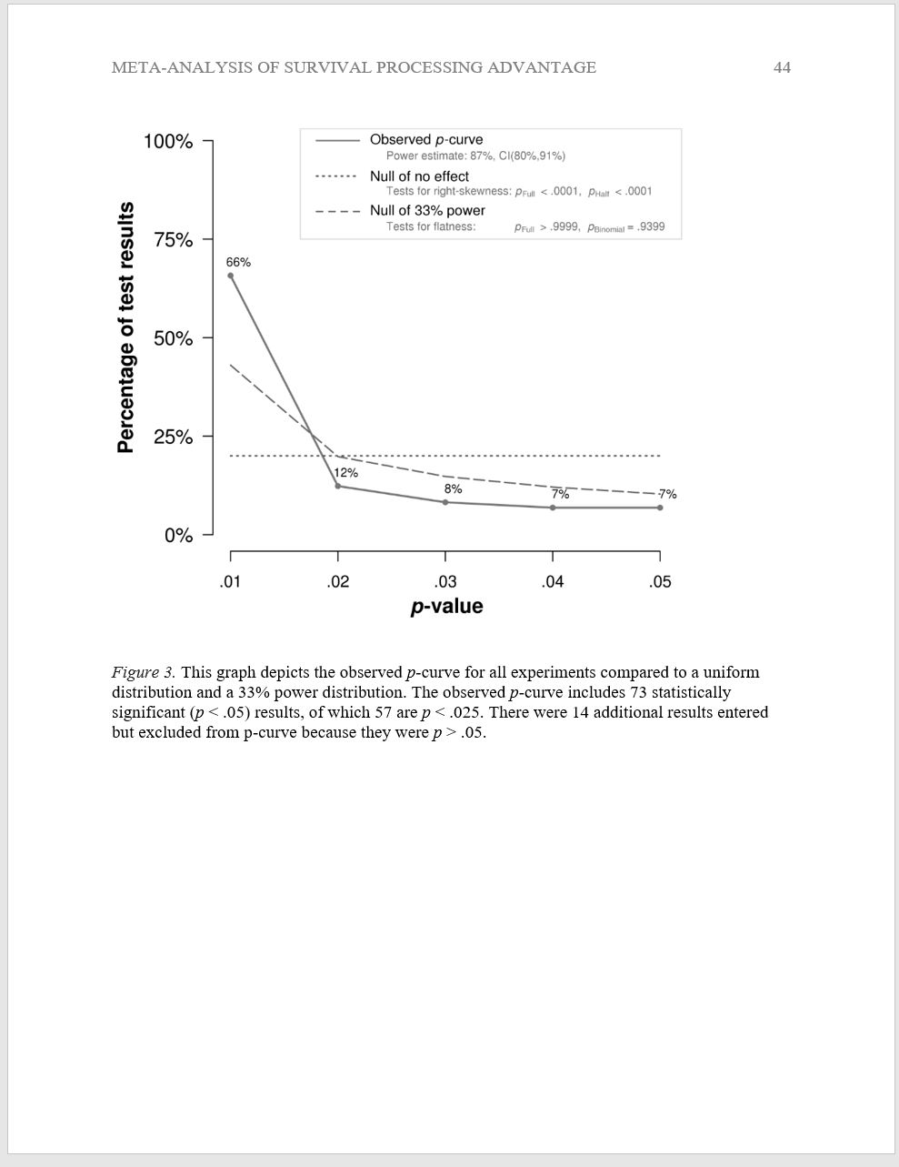
Figures

Slide 12
References – Rules of the Road
Two ways to cite in text
Following the rating procedure, participants received a memory test (Nairne, Pandeirada, & Thompson, 2008).
Nairne, Pandeirada, and Thompson (2008) had participants perform a memory test.
If one or two authors – always list all of the authors.
If 3 – 5 authors – first time you cite them in text, list all authors. Second time, shorten to (et al.)
(Nairne, Pandeirada, & Thompson, 2008) → (Nairne et al., 2008)
Nairne, Pandeirada, and Thompson (2008) → Nairne et al. (2008)
> 5 authors, just use et al.
If citing same article within the same paragraph, list date first time and omit date in subsequent citations
Nairne et al. (2008) → Nairne et al.
(Nairne et al., 2008) → (Nairne et al.)

Slide 13
References – Rules of the Road
Nairne, J. S., Pandeirada, J. N., & Thompson, S. R. (2008). Adaptive memory: The comparative value of survival processing. Psychological Science, 19(2), 176-180. doi:10.1111/j.1467-9280.2008.02064.x
Hedges, L., & Olkin, I. (1985). Statistical models for meta-analysis. New York, NY: Academic Press.
Lilienfeld, S. O., & Lynn, S. J. (2003). Dissociative identity disorder: Multiple personalities, multiple controversies. In S. O. Lilienfeld, S. J. Lynn, & J. M. Lohr (Eds.), Science and pseudoscience in clinical psychology (pp. 109-142). New York, NY: Guilford Press.

